Slide 1
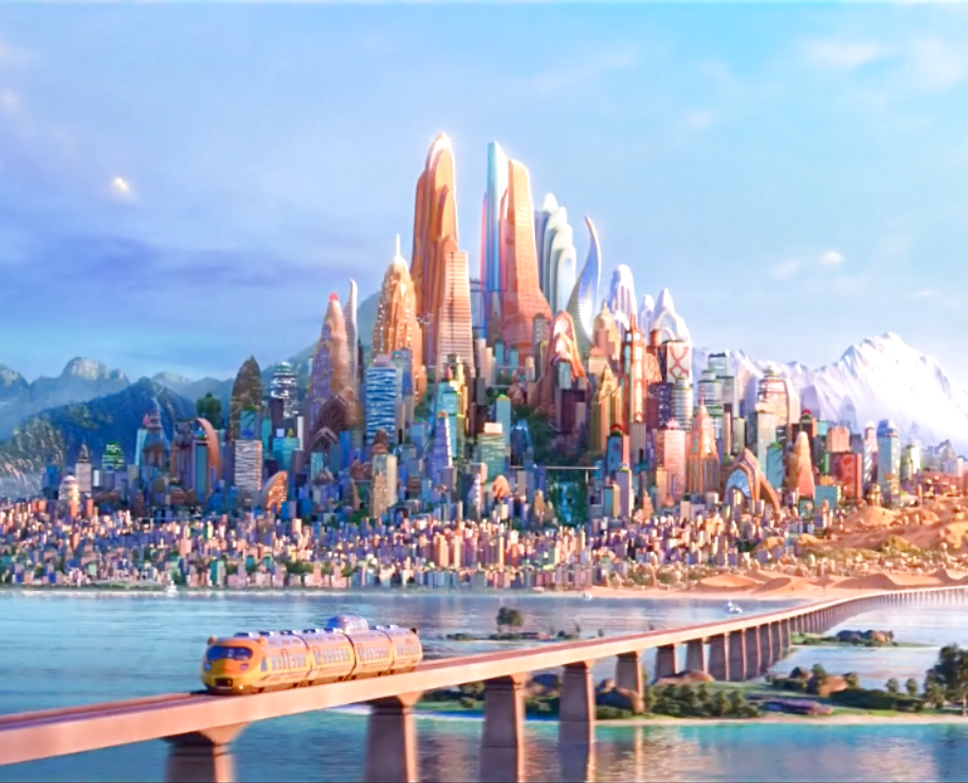

Racism or Racist

Slide 2
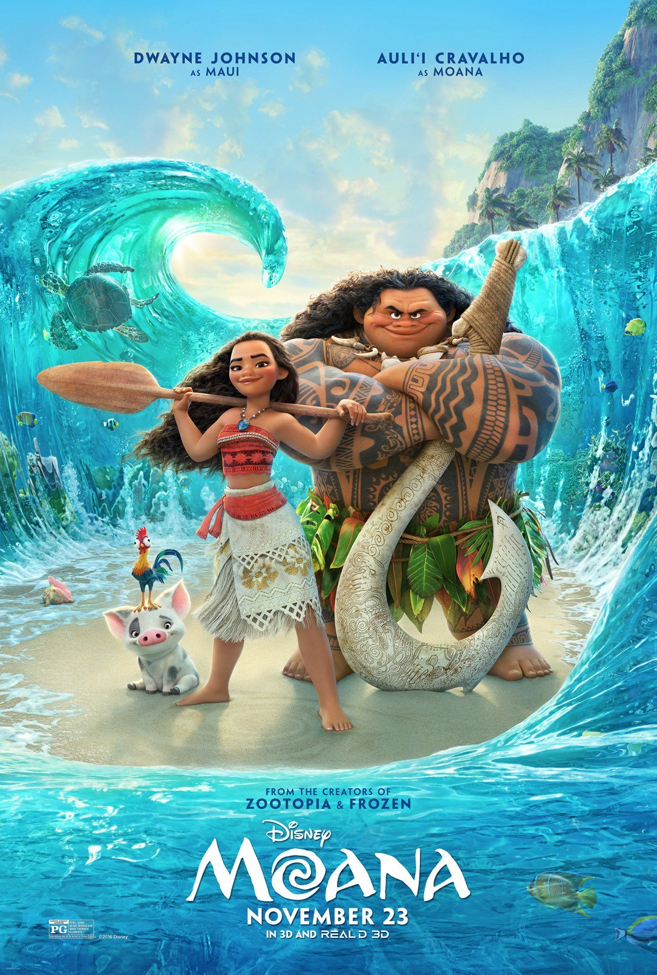
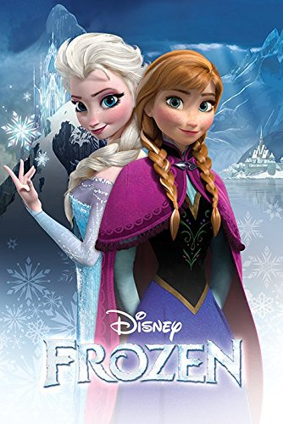
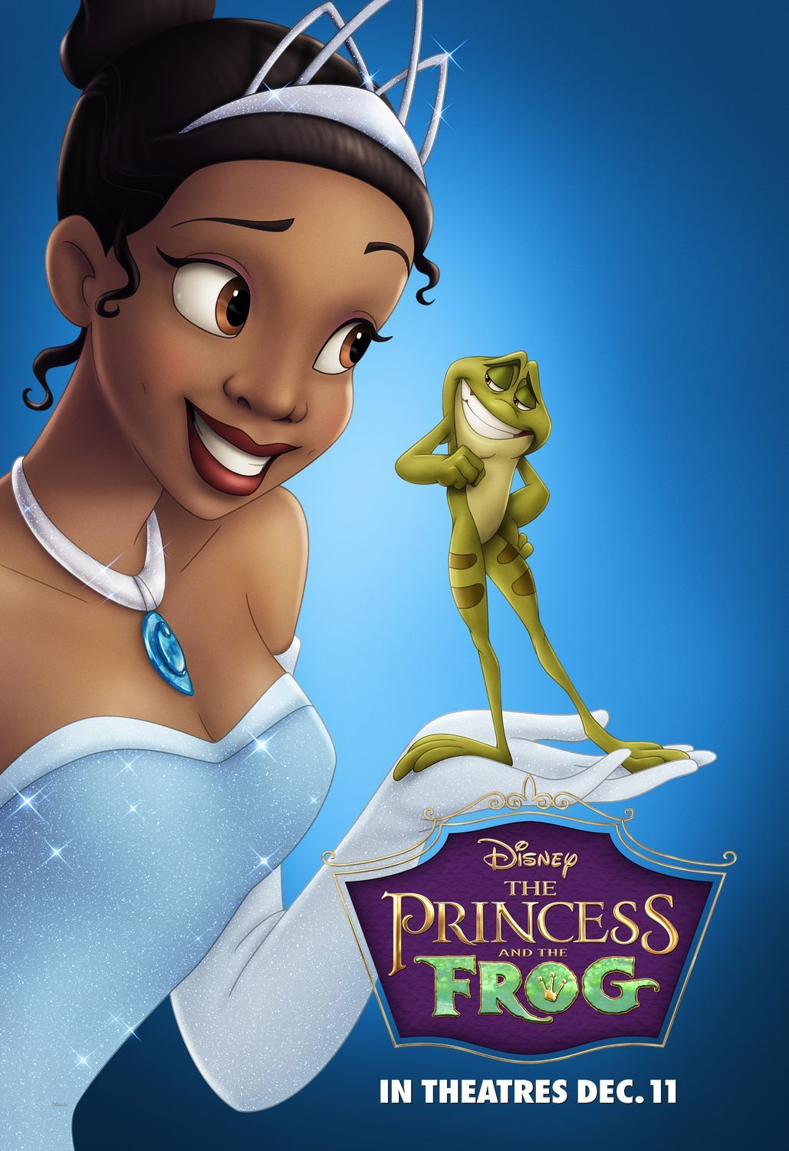
Recent Films by Disney Dealing Social Issues

Slide 3
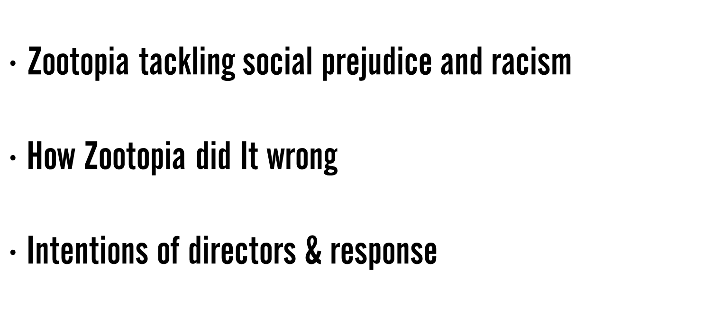
Introduction
$∙$Zootopia tackling social prejudice and racism
$∙$ How Zootopia did It wrong
$∙$ Intentions of directors & response
- Curie Kim
- Dongeun Kim
- Jiwon Lee

Slide 4
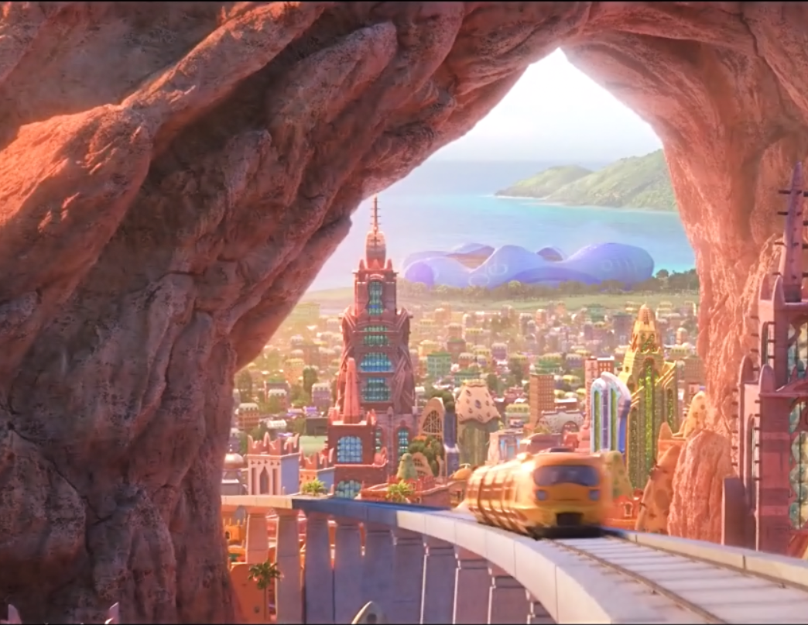
Zootopia Tackling Social Prejudice and Racism

Slide 5
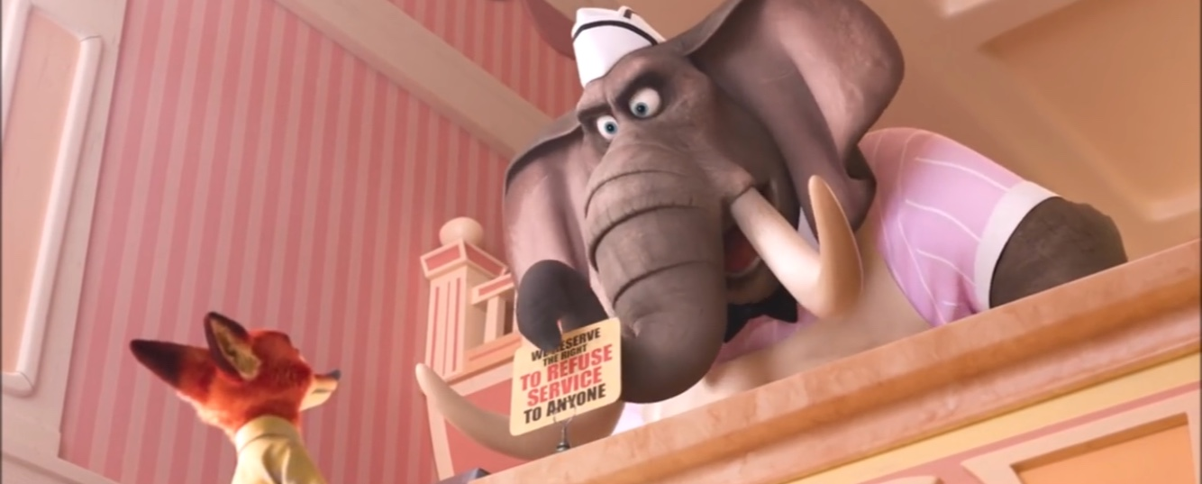
Scenes With Discrimination
“We reserve the right to refuse service to anyone.”

Slide 6
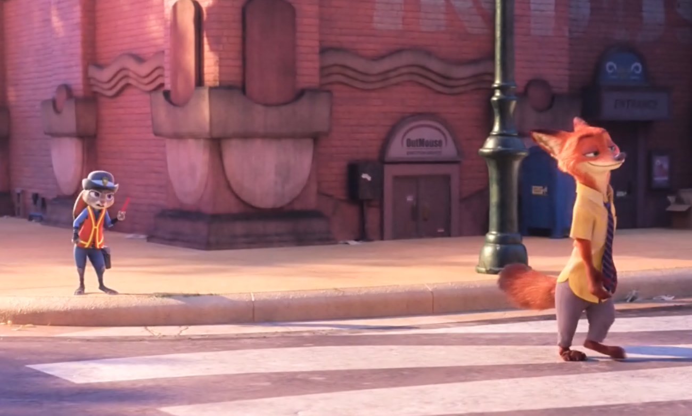
Scenes With Discrimination
“You're gonna wanna refrain from calling me Carrots!”

Slide 7
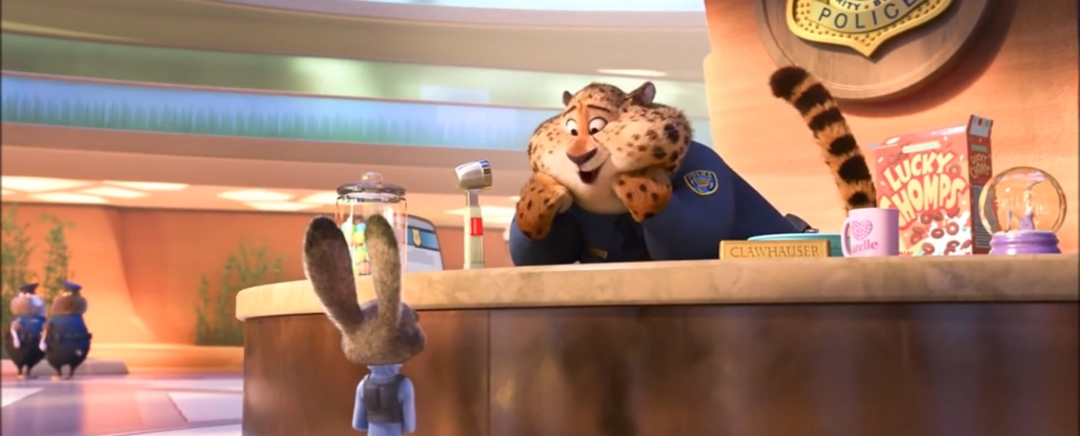
Scenes With Discrimination
“A bunny can call another bunny 'cute', but when other animals do it, that's a little...”

Slide 8
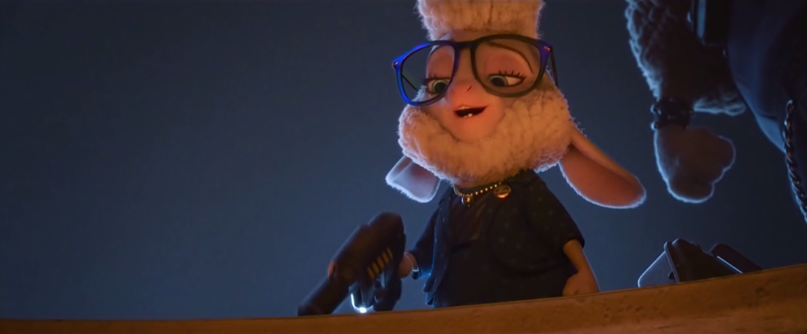
Scenes With Discrimination
“Fear always works.”

Slide 9

EUTOPIA?
!

Slide 10
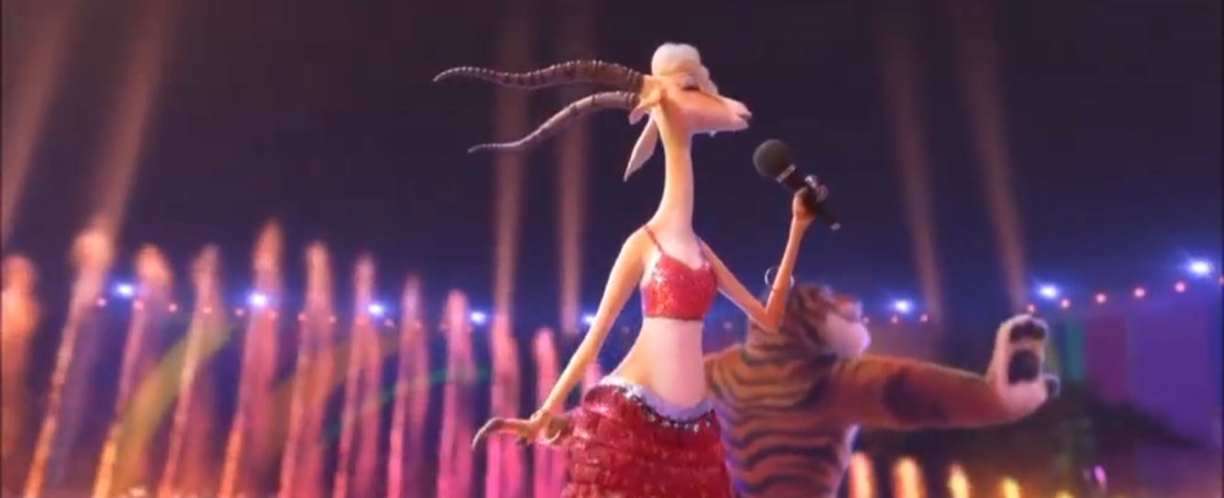
Gazelle’s Song
“Try Everything”

Slide 11
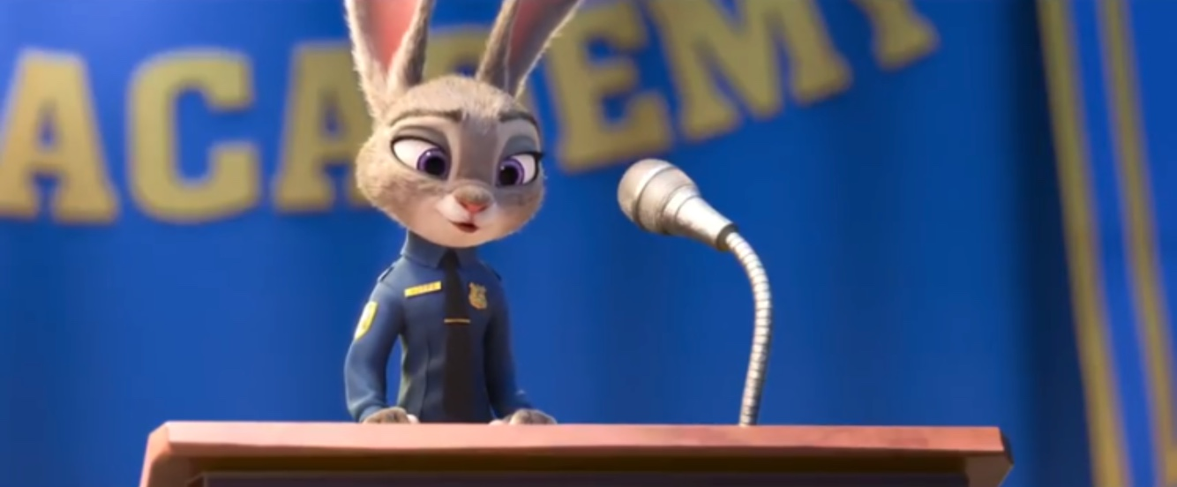
Judy’s Speech
“We all have limitations. We all make mistakes. And the more we try to understand one another, the more exceptional each of us will be. But we have to try. So no matter what type of animal you are, I implore you. Try to make the world a better place.”

Slide 12
How Zootopia Did It Wrong : Was Disney really successful in discouraging stereotypes?

Slide 13
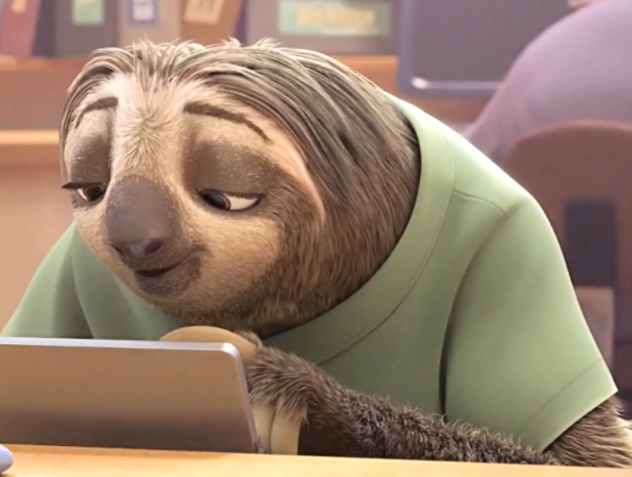
Stereotypical Behaviors of Animals
→ Undermines the main message of discouraging stereotypes

Slide 14
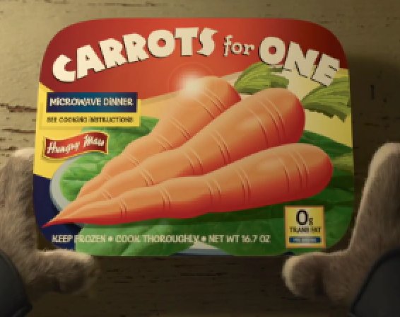
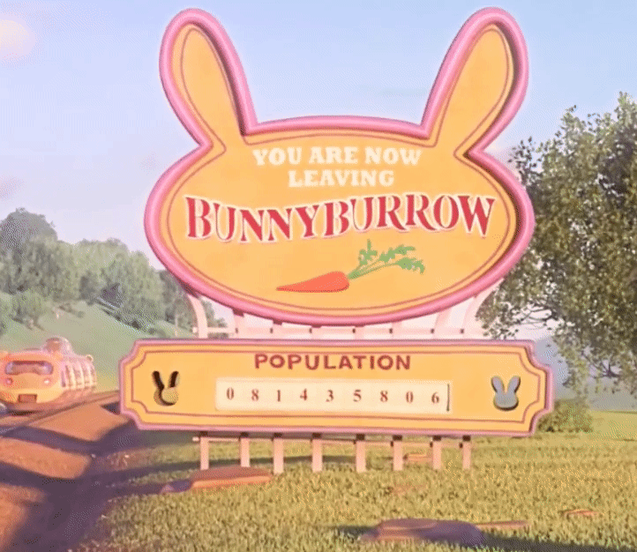
Example: Bunnies
Carrots
Prolificacy

Slide 15
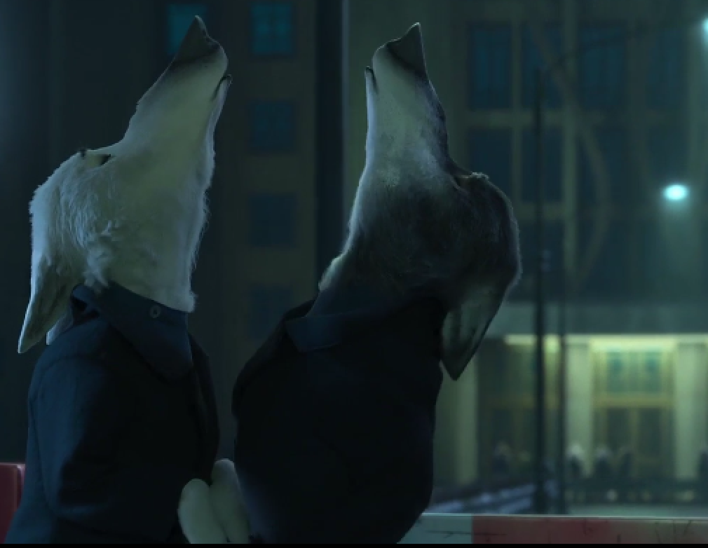
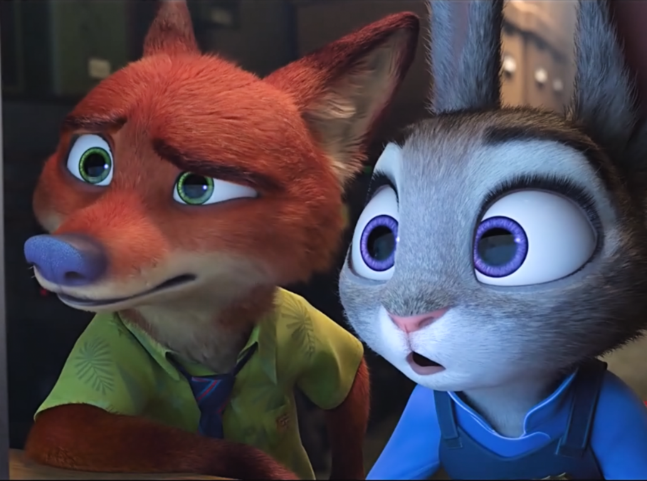
Example: Wolves
“What is it with wolves and the howling?”

Slide 16
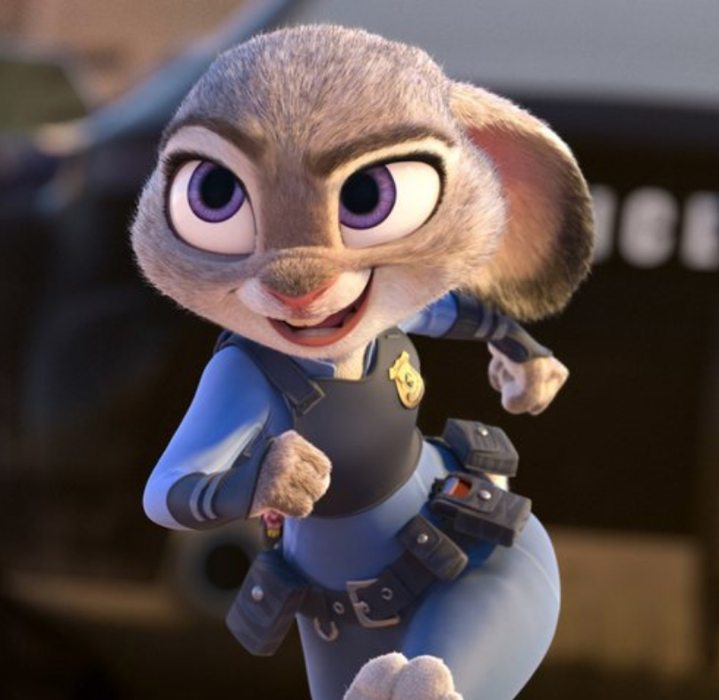
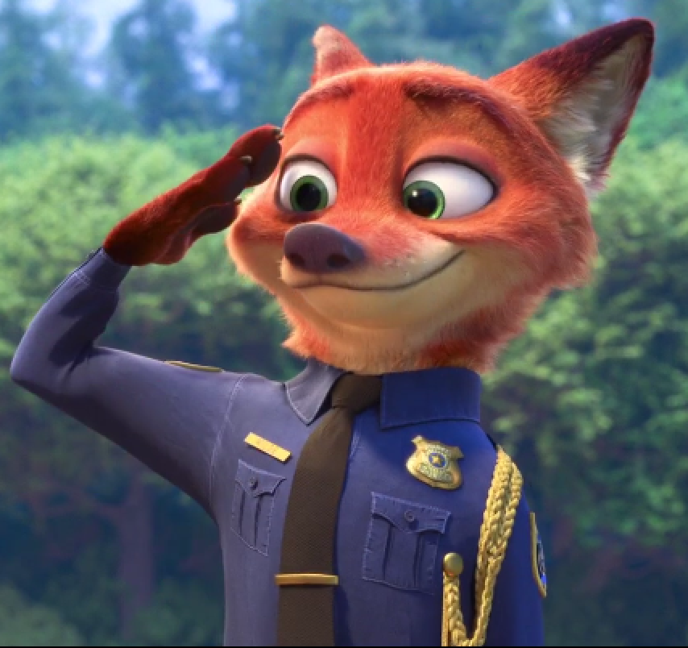
Different because these stereotypes are not countered
Bunnies : weak?
Foxes : sly?
Judy : competent
Nick : brave & trustworthy
→ Reinforces the idea that particular groups behave in a characteristic way

Slide 17
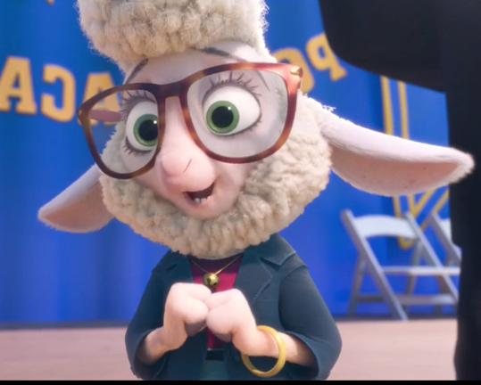
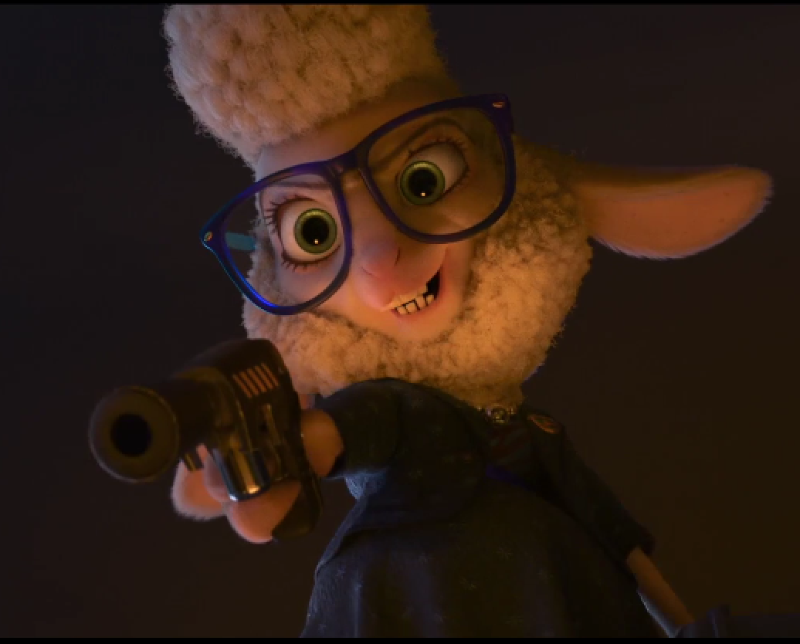
Identity of the Conspirer
She is actually…
The ultimate villain
→ socially suppressed groups are actually against the socially superb groups, . and are willing to harm them in order to step up the social ladder

Slide 18
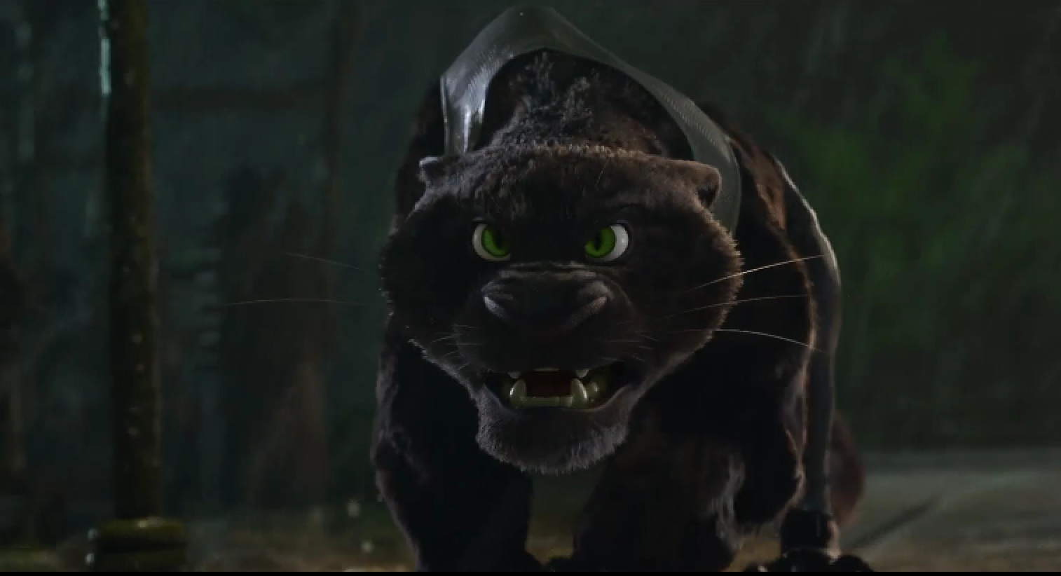
Black Panther
Jaguar that attacks Nick and Judy is black
→ latently associates black skin color with negative, dangerous characteristics

Slide 19
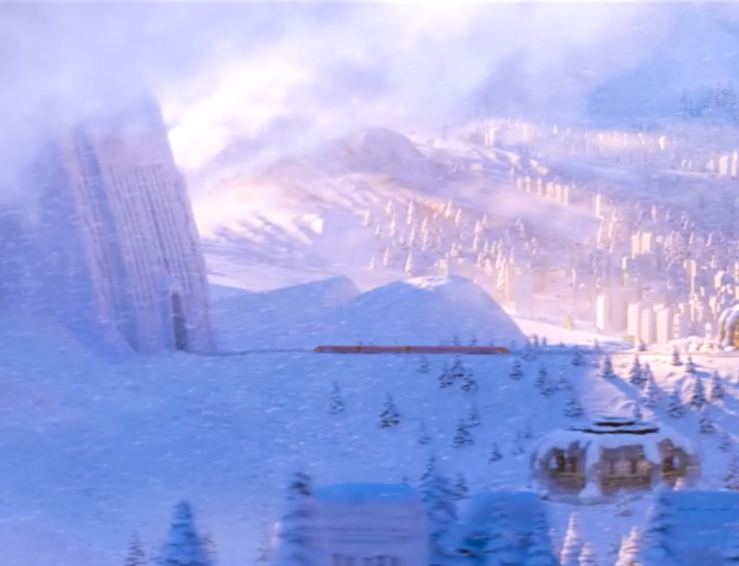
Intentions of Directors & Response

Slide 20
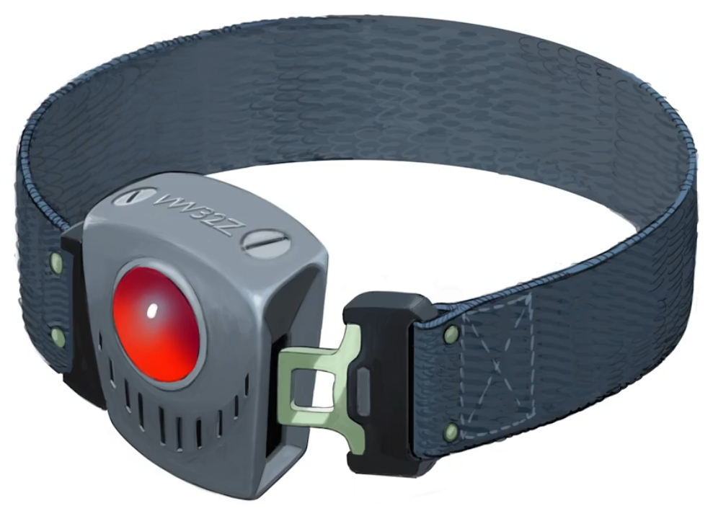
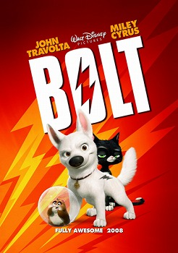
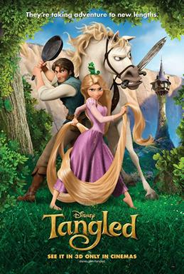
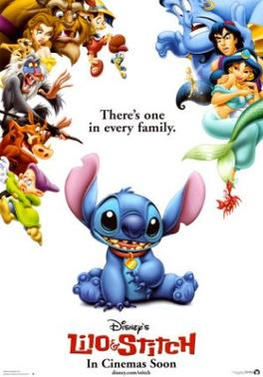
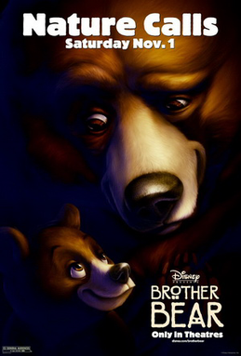
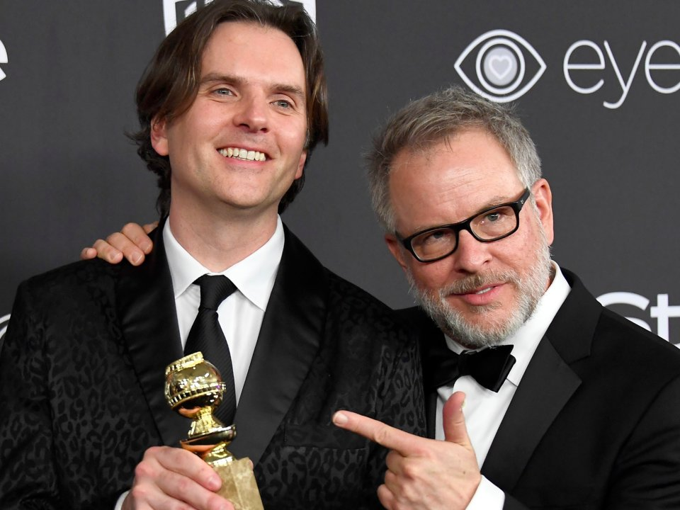
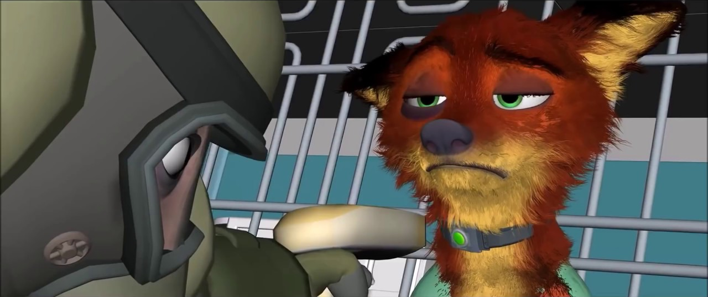
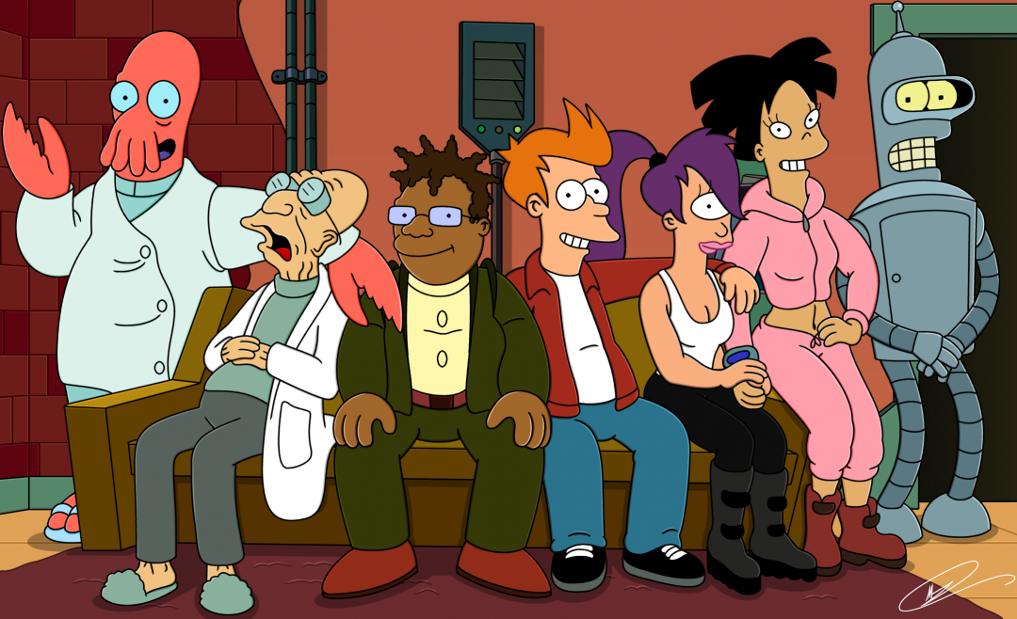
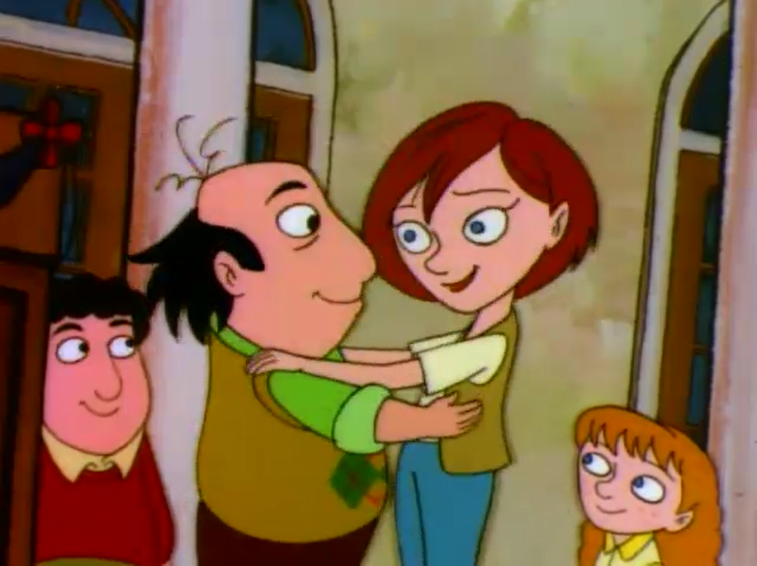
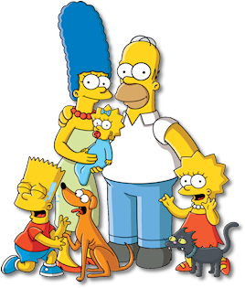
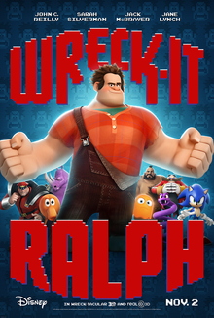
Directors’ Intentions
Byron Howard and Rich Moore
An anecdote: trip to Kenya (Guerrasio, 2017)
Injustice, discrimination, and racism (Riley, 2017)
Major changes in production process (Sciretta, 2016)

Slide 21
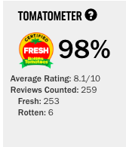
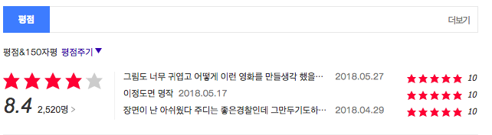
Critical Response
Overall positive
Thought-provoking, subversive, and compelling with its timely message (Genzlinger, 2016) (Travers, 2016)
(Daum movies, 2018)
(Rottentomatoes.com, 2018)

Slide 22
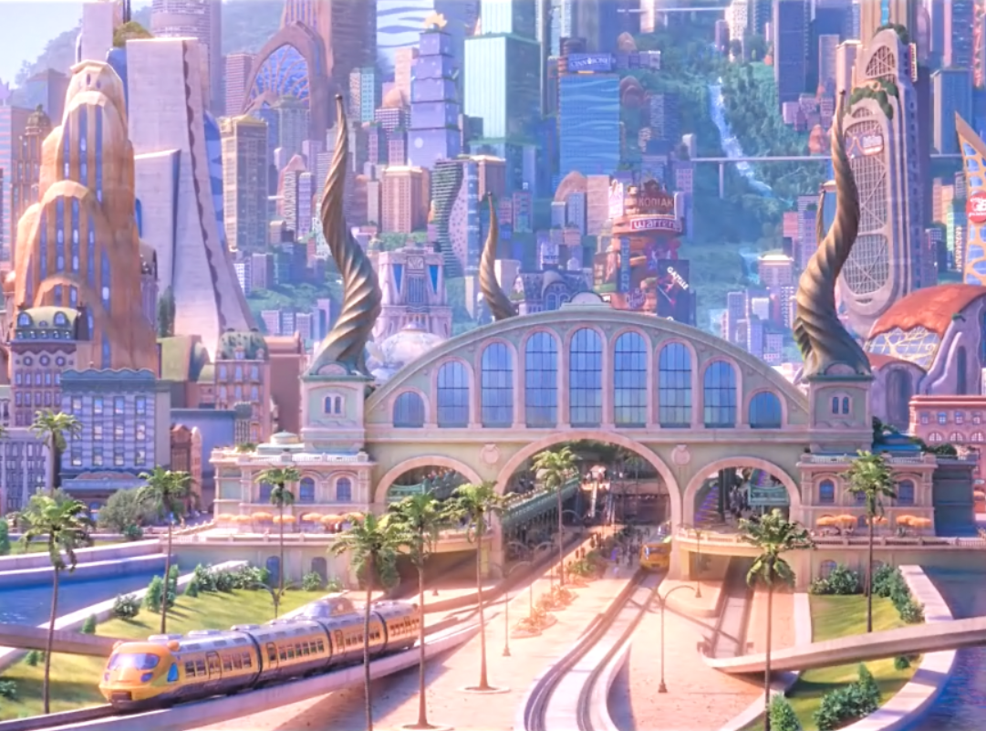
Conclusion

Slide 23
Works Cited & Referred
Daum 영화. (2018). Daum영화 <주토피아>. [online] Available at: http://movie.daum.net/moviedb/grade?movieId=89720 [Accessed 4 Jun. 2018].
Genzlinger, N. (2016). Review: In ‘Zootopia,’ an Intrepid Bunny Chases Her Dreams. [online] Nytimes.com. Available at: https://www.nytimes.com/2016/03/04/movies/zootopia-review.html [Accessed 5 Jun. 2018]
Guerrasio, J. (2017). 'Zootopia' directors: Why the movie has a special meaning after the Trump victory. [online] Business Insider. Available at: http://www.businessinsider.com/zootopia-meaning-trump-presidency-2017-1 [Accessed 3 Jun. 2018].
Leadbeater, A. and Donaldson, K. (2016). Zootopia Directors Explain Characters & Challenges of Maintaining Scale. [online] Screenrant.com. Available at: https://screenrant.com/zootopia-directors-interview-characters/ [Accessed 4 Jun. 2018].
Riley, J. (2017). ‘Zootopia’ Helmers Byron Howard, Rich Moore on Their Timely, Subversive Toon. [online] Variety. Available at: https://variety.com/2017/film/in-contention/oscar-nominated-directors-zootopia-1201989619/ [Accessed 4 Jun. 2018].
Rottentomatoes.com. (2018). Zootopia. [online] Available at: https://www.rottentomatoes.com/m/zootopia/ [Accessed 4 Jun. 2018]
Sciretta, P. (2016). Zootopia Directors Interview: The Evolution Of The Story. [online] /Film. Available at: http://www.slashfilm.com/zootopia-directors-interview/2/ [Accessed 5 Jun. 2018].
Travers, P. (2016). 'Zootopia' Movie Review. [online] Rolling Stone. Available at: https://www.rollingstone.com/movies/reviews/zootopia-20160303 [Accessed 4 Jun. 2018].

Slide 24
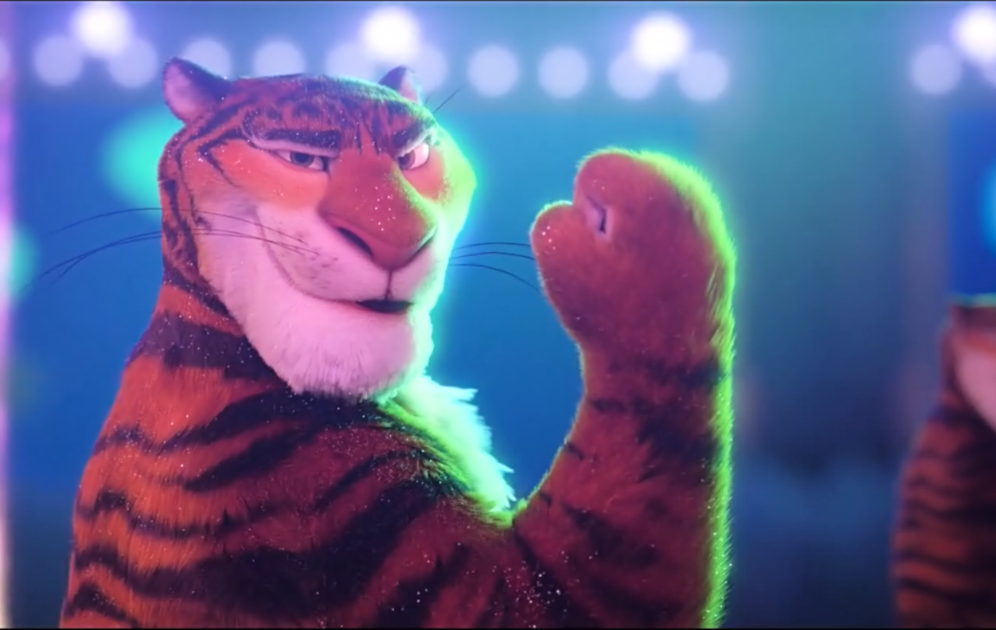
Thanks For Listening

